Slide 1
Attendease: FACE RECOGNITION System
PRESENTED BY:
INF/004/22 Jacinta Omondi
COM/012/22 James Ngandu
COM/088/22 Henry Ouma
COM/017/22 David Wambua

Slide 2
Introduction
Overview:
Traditional attendance system are time consuming, error-prone, and susceptible to proxy marking.
Attendease leverages AI and Computer Vision to automate student attendance using facial recognition, improving accuracy, efficiency, and academic integrity
Key Features:
Real-Time Face Detection & Recognition
Automated Attendance Marking
Web-Based Interface (User-Friendly)
Role-Based Access (Admin, Teacher)

Slide 3
Problem Statement
In educational institutions, accurate tracking of student attendance is crucial for monitoring academic engagement and ensuring accountability. However, traditional attendance systems—such as manual roll calls, sign-in sheets, and RFID-based methods—are plagued with numerous inefficiencies and vulnerabilities.
These include:
Time-consuming processes , especially in large classrooms, which disrupt teaching time.
Human errors that result in inaccurate attendance records.
Fraudulent practices , where students mark attendance on behalf of their absent peers.
Administrative overhead caused by paper-based or poorly digitized record-keeping, making data management and analysis difficult.
These limitations call for a more secure, efficient, and automated solution that eliminates human intervention and reduces the potential for misuse.

Slide 4
Objectives
- Develop real-time face recognition system
- Automate attendance logging
- Prevent proxy attendance with secure authentication
- Provide user-friendly interface and real-time reports

Slide 5
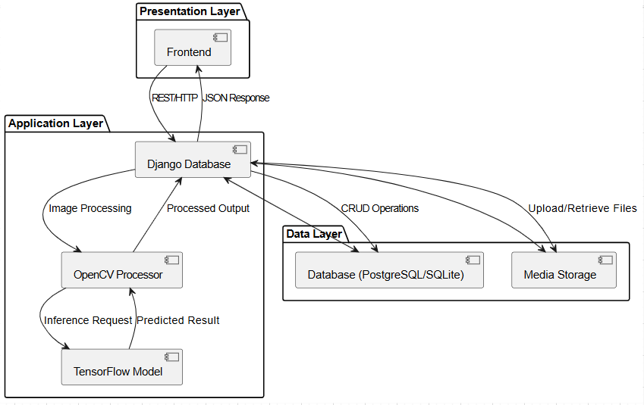
System Architecture Diagram

Slide 6
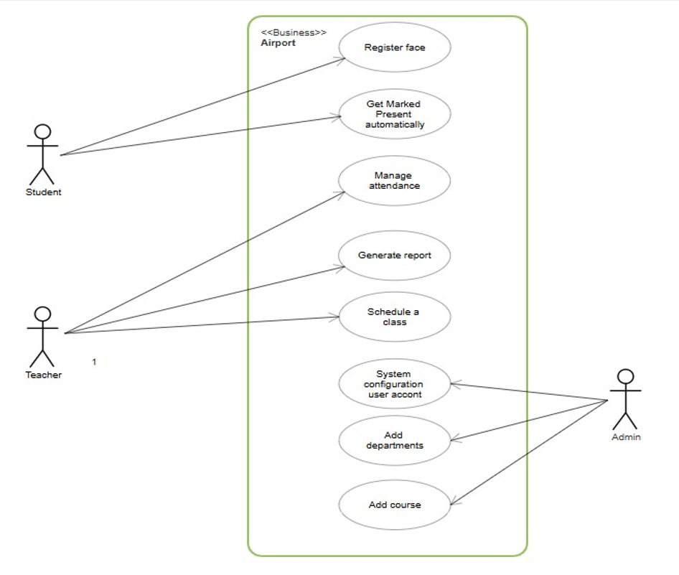
Use Case Diagram

Slide 7
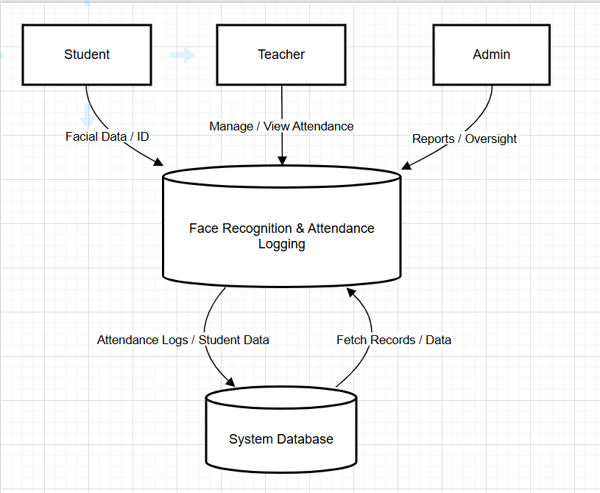
Data Flow Diagram (Level 0)

Slide 8
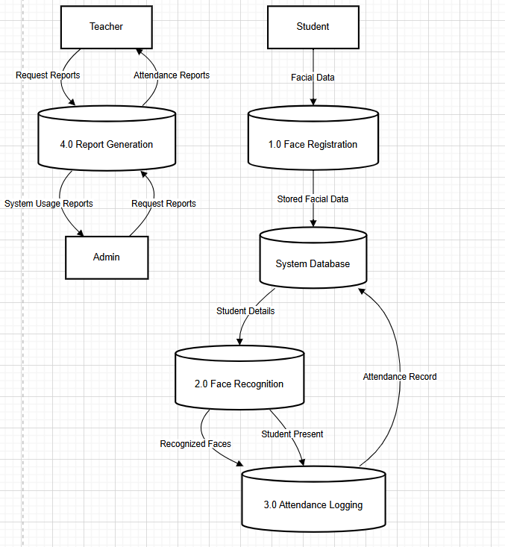
Data Flow Diagram (Level 1)

Slide 9
Key Features
- Real-time facial recognition for attendance
- Secure authentication to prevent proxy attendance
- User-friendly dashboards for teachers and admins
- Real-time attendance reports and analytics
- Scalable database management with PostgreSQL

Slide 10
Technologies Used
- Backend: Django, TensorFlow, OpenCV, face_recognition
- Frontend: HTML, Tailwind CSS, JavaScript, Face_API.js
- Database: PostgreSQL, SQLite
- Tools: Git, GitHub, Docker, AWS/Heroku

Slide 11
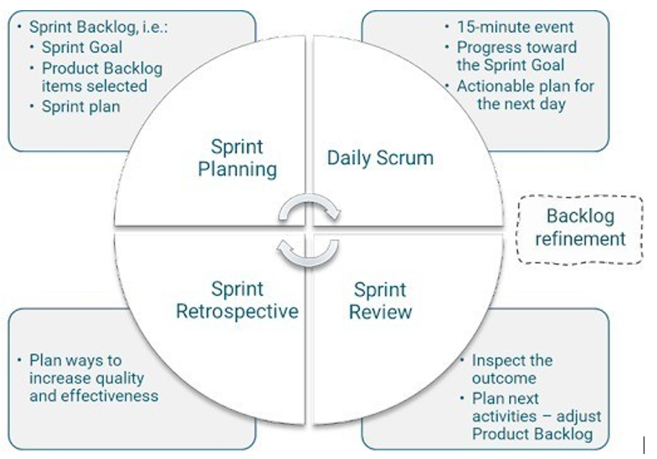
Development Methodology
Agile Workflow Overview
Sprint Planning: Tasks (e.g., backend setup, UI design, face recognition) were prioritized by complexity and dependencies.
Daily Standups: Short meetings enabled progress tracking, issue resolution, and team alignment.
Sprint Development:
Sprint 1: Django-based user registration & attendance.
Sprint 2: Face recognition pipeline setup.
Frequent code reviews ensured quality.
Testing & Review: Each sprint ended with feature testing (accuracy, UI responsiveness, bugs fixed collaboratively).
Deployment & Feedback: Post-sprint deployments included peer/supervisor reviews, driving iterative improvements.

Slide 12
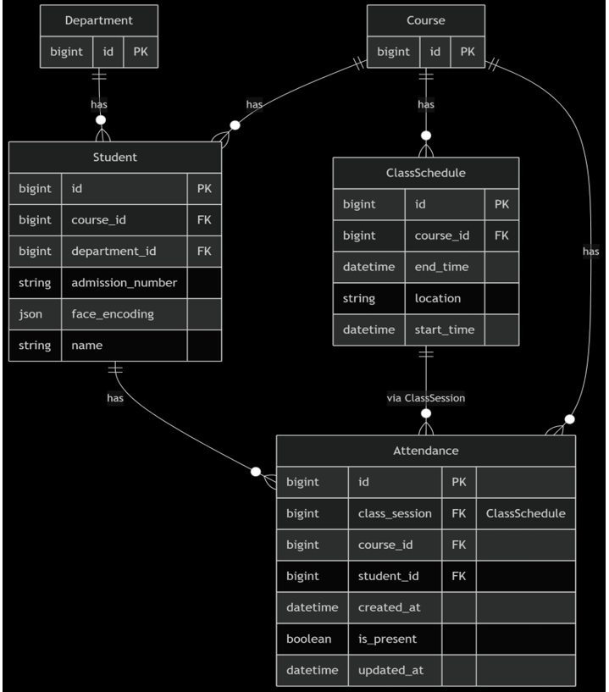

Slide 13
Challenges and Solutions
- Challenge: Low accuracy in poor lighting
Solution: Image preprocessing (histogram equalization)
- Challenge: Slow face matching for large datasets
Solution: Faiss indexing for faster searches
- Challenge: Browser camera restrictions
Solution: HTTPS and permission handling

Slide 14
Results and Performance
- Achieved >75% facial recognition accuracy
- Real-time attendance marking (~1-2 seconds/student)
- Scalable for large classes (up to 10 students)
- Positive user feedback on usability and interface

Slide 15
Conclusion and Recommendations
Conclusions
Attendease introduces an AI-powered solution to modernize attendance tracking in educational institutions. By integrating facial recognition, Django backend, and machine learning tools (TensorFlow, Face_API.js) , the system eliminates inefficiencies, human errors, and proxy marking associated with traditional methods.
Key Recommendations
Scalability : Optimize for large-scale deployment across multiple classrooms and institutions.
Data Security : Implement advanced encryption and comply with privacy laws like GDPR.
Integration : Connect with existing LMS and student databases for seamless workflows.
Improved Accuracy : Enhance facial recognition under varied lighting and occlusion conditions.
Mobile App : Develop a mobile version for increased accessibility.
User Training & Support : Provide training programs and technical support for staff.
Ethical Use Policy : Establish clear guidelines on consent, transparency, and responsible use of biometric data.

